Slide 1

Lodging Tax in the Modern Era
MNTA Education Summit
June 4, 2026

Slide 2


Facilitator
Rachel Thompson
Visit Greater St. Cloud

Slide 3
Minnesota’s Lodging Tax Statute
§ 469.190
Established in 1983
Authorizes a community to impose a lodging tax up to 3%
Describes how the proceeds can be spent
  5% can be retained by taxing authority – no restrictions
  “95% shall be used to fund a local convention or tourism bureau for the purpose of marketing and promoting the city or town as a tourist or convention center.”
Collection
  Local Taxing Authority
  MN Dept. of Revenue

Slide 4
Exceptions
Bloomington, Duluth, St. Paul, Rochester, St. Cloud and Minneapolis lodging tax revenue is not governed by the same statute and have been “grandfathered in” under different legislation and circumstances.
Special legislation must be obtained to use lodging tax for a purpose that does not fund a local convention or tourism bureau for the purpose of marketing and promoting the city or town as a tourist or convention center OR to seek more than the 3% allowed by § 469.190

Slide 5
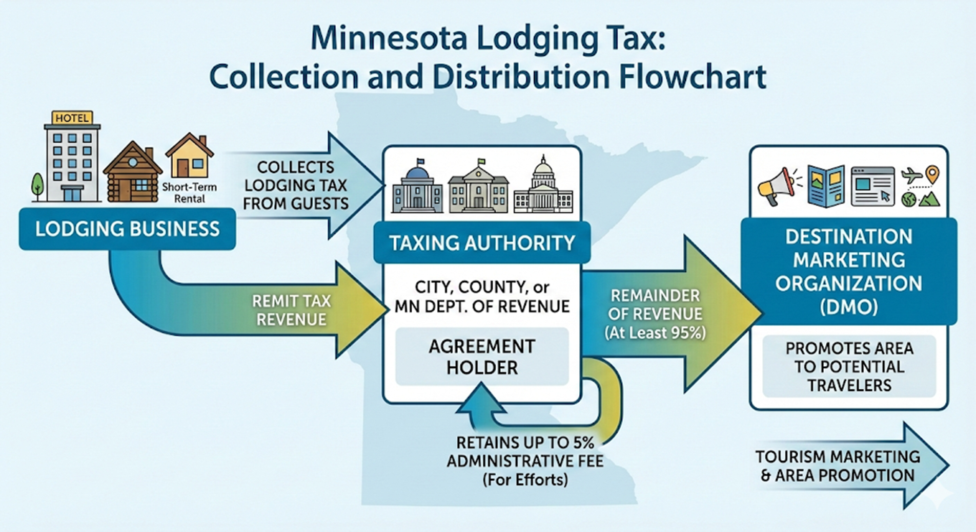

Governing Documents – City/County Ordinance
Collection (Relationship with lodging property)
Contract for Services with Marketing Partner
Up to 5% can be retained by taxing authority
95% to DMO
(Panelists share examples of their agreements, written, verbal, annual, on-going…no one-size-fits-all.)
Notes:
Implementation
Governing Documents – City/County Ordinance
Collection (Relationship with lodging property)
Contract for Services with Marketing Partner
Up to 5% can be retained by taxing authority
95% to DMO
(Panelists share examples of their agreements, written, verbal, annual, on-going…no one-size-fits-all.)

Slide 6
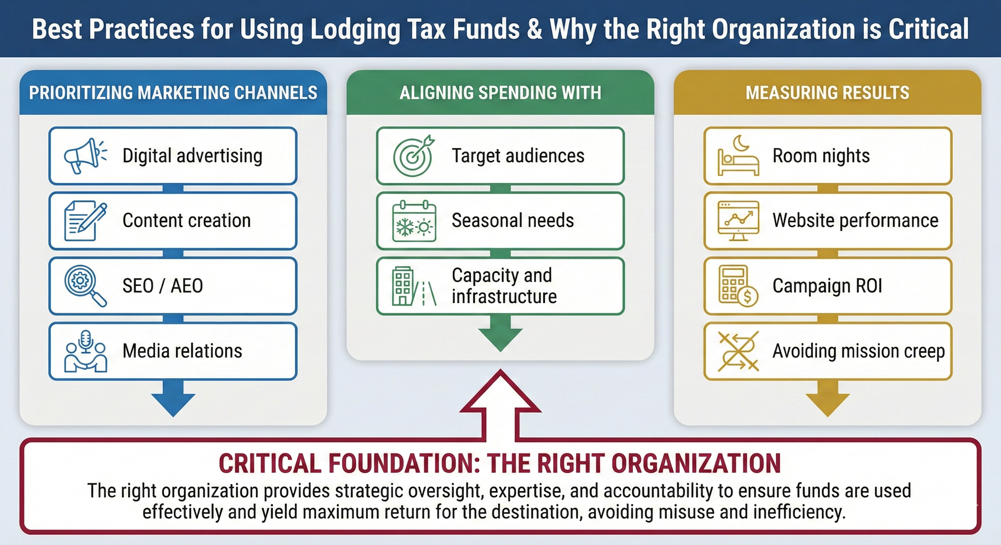
Marketing Your Community
Notes:
Panelists share examples of how they spend lodging tax dollars to market.
Work with their boards. Promote regional/community assets
Heads in beds.
(Panelists share examples of economic benefits of tourism)
Examples of how lodging tax dollars are spent
Direct spending, indirect spending, Zartico statistics, value of employees (job numbers and spending) etc. Examples of events/activities that impact room/lodging tax revenue i.e. winter snow conditions

Slide 7
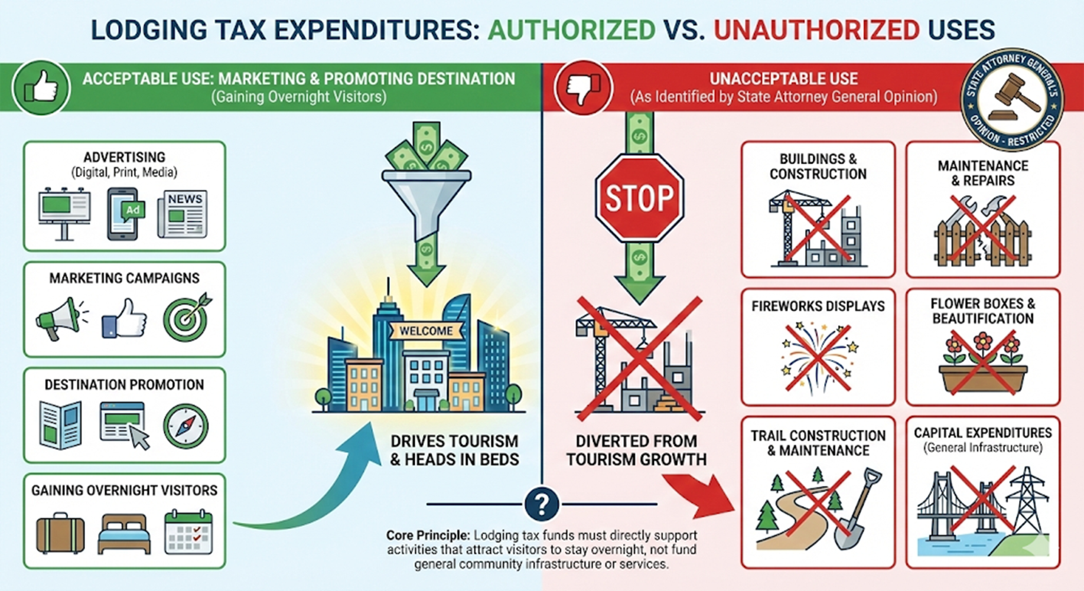
Notes:
AG opinions and examples
i.e. Fireworks, flower boxes, building and or maintenance of infrastructure, brick and mortar, building trails, expenses for community events EXCEPT for marketing support, etc.
(Panelists share examples of requests they’ve denied because the expenditure doesn’t fit)

Slide 8
Rachel’s 2 Test method
If I cannot say YES, I have to say NO to funding it!
Does it promote/market my region to VISITORS?
Does it BRING visitors into my region? (NOT CAPITAL)

Slide 9
Unrestricted & Other Funding Options
Grant Funding
Tourism Improvement Districts
Sponsorship/Advertising Dollars
Additional/Other Taxes (these require legislative approval)
City Budget/Levy
Memberships/Sponsorships

Slide 10
Disclaimer
The information shared today should not be taken as legal counsel. Instead, it serves as a compilation of best practices that align with the intent of the legislation and the original purpose of the local lodging tax.

Slide 11
Q & A
WHAT HAS BEEN REQUESTED OF YOU THAT YOU HAVE QUESTIONED IF YOU SHOULD USE LODGING TAX FUNDS FOR?
Let’s Work to Protect our Industry and Advocate for Proper Use of Funds!

