Slide 1

Dialing In High Level Conversations
MNTA Education Summit
June 2026

Slide 2


Leveraging Self-Awareness for
Advocacy Success

Slide 3
We Give and Receive Feedback Constantly
We don’t realize it.
Every interaction.
Every response.
Every non-response.
Every time we exchange any form of verbal or non-verbal communication,
we are giving and/or receiving feedback.

Slide 4
Communication points hidden as forms
of feedback:
Body language
Facial expressions
Voice and tone used
Verbal praise (yes, praise is feedback!)
Lack of response, follow through, or action
What work gets prioritized, what doesn’t

Slide 5
Why Does Conflict Occur?
Two (or more) parties are not aligned:
❌ Quality of execution does not meet expectations.
❌ Priorities do not meet expectations.
❌ Behavior/attitude/conduct does not meet expectations.

Slide 6

Embracing Difficult Conversations

Slide 7
10 Steps to Effectively Manage
Difficult Conversations
PREPARE your desired outcomes for the conversation

Slide 8
10 Steps to Effectively Manage
Difficult Conversations
1. PREPARE your desired outcomes for the conversation
2. Show your CARE for them as a human right away

Slide 9
10 Steps to Effectively Manage
Difficult Conversations
1. PREPARE your desired outcomes for the conversation
2. Show your CARE for them as a human right away
3. CHOOSE YOUR WORDS in a way that shows you're on the same team, striving for the same goal

Slide 10
10 Steps to Effectively Manage
Difficult Conversations
1.. PREPARE your desired outcomes for the conversation
2. Show your CARE for them as a human right away
3. CHOOSE YOUR WORDS in a way that shows you're on the same team, striving for the same goal
4. Remove EMOTION from the conversation

Slide 11
Advocacy Case Study:
Albany, NY TID
Jill Delaney, President/CEO

Slide 12
10 Steps to Effectively Manage
Difficult Conversations
1. PREPARE your desired outcomes for the conversation
2. Show your CARE for them as a human right away
3. CHOOSE YOUR WORDS in a way that shows you're on the same team, striving for the same goal
4. Remove EMOTION from the conversation
5. Be patient, and take notes as you LISTEN ACTIVELY

Slide 13

Fight the Instinct to Defend
Try to avoid the primary instinct to explain why you did something.
Gut reactions to explain tend to come off as defensive.
Pause before responding to fully listen and be measured in response.

Slide 14
10 Steps to Effectively Manage
Difficult Conversations
1. PREPARE your desired outcomes for the conversation
2. Show your CARE for them as a human right away
3. CHOOSE YOUR WORDS in a way that shows you're on the same team, striving for the same goal
4. Remove EMOTION from the conversation
5. Be patient and take notes as you LISTEN ACTIVELY
6. STAY ON TOPIC and don't allow for distractions (remember your desired outcomes)

Slide 15
10 Steps to Effectively Manage
Difficult Conversations
1. PREPARE your desired outcomes for the conversation
2. Show your CARE for them as a human right away
3. CHOOSE YOUR WORDS in a way that shows you're on the same team, striving for the same goal
4. Remove EMOTION from the conversation
5. Be patient, and take notes as you LISTEN ACTIVELY
6. STAY ON TOPIC and don't allow for distractions (remember your desired outcomes)
7. Gain alignment on EXPECTATIONS moving forward

Slide 16
10 Steps to Effectively Manage
Difficult Conversations
1. PREPARE your desired outcomes for the conversation
2. Show your CARE for them as a human right away
3. CHOOSE YOUR WORDS in a way that shows you're on the same team, striving for the same goal
4. Remove EMOTION from the conversation
5. Be patient, and take notes as you LISTEN ACTIVELY
6. STAY ON TOPIC and don't allow for distractions (remember your desired outcomes)
7. Gain alignment on EXPECTATIONS moving forward
8. BE SPECIFIC in your agreements, next steps, and action items

Slide 17
10 Steps to Effectively Manage
Difficult Conversations
1. PREPARE your desired outcomes for the conversation
2. Show your CARE for them as a human right away
3. CHOOSE YOUR WORDS in a way that shows you're on the same team, striving for the same goal
4. Remove EMOTION from the conversation
5. Be patient, and take notes as you LISTEN ACTIVELY
6. STAY ON TOPIC and don't allow for distractions (remember your desired outcomes)
7. Gain alignment on EXPECTATIONS moving forward
8. BE SPECIFIC in your agreements, next steps, and action items
9. Share your GRATITUDE for them, their time, and their attention

Slide 18
10 Steps to Effectively Manage
Difficult Conversations
1. PREPARE your desired outcomes for the conversation
2. Show your CARE for them as a human right away
3. CHOOSE YOUR WORDS to show you're on the same team, striving for the same goal
4. Remove EMOTION from the conversation
5. Be patient, and take notes as you LISTEN ACTIVELY
6. STAY ON TOPIC and don't allow for distractions (remember your desired outcomes)
7. Gain alignment on EXPECTATIONS moving forward
8. BE SPECIFIC in your agreements, next steps, and action items
9. Share your GRATITUDE for them, their time, and their attention
10. Clearly state agreements and reaffirm next steps IN WRITING

Slide 19
Receiving
Feedback Well

Slide 20
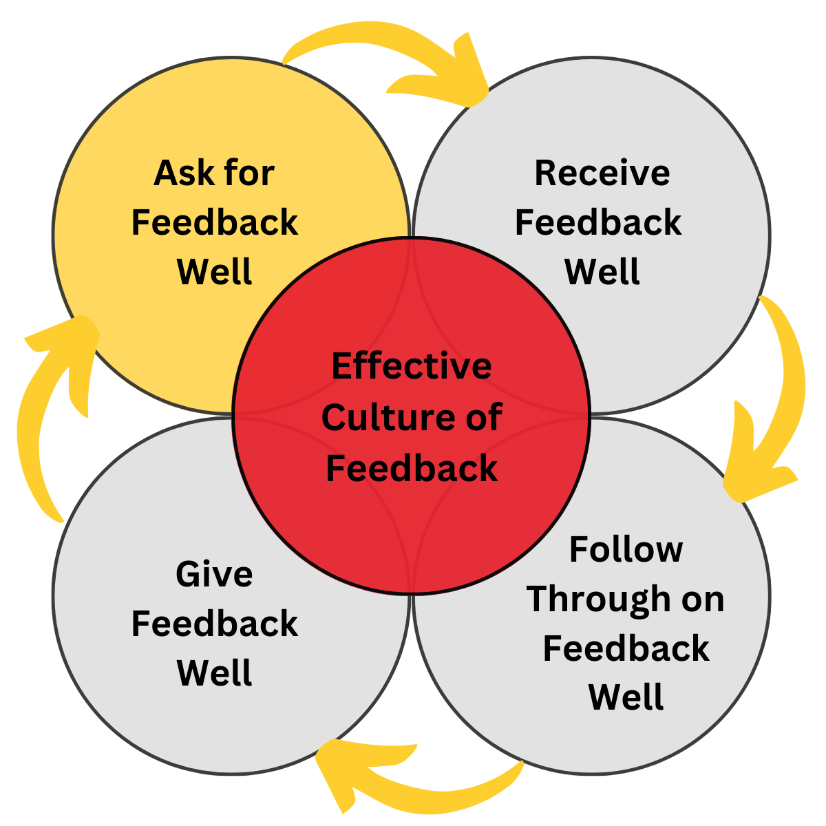
How to Build a Culture of Feedback

Slide 21

Ask for Feedback Well
Establish routine
Be proactive - stop expecting others to come to you!
Provide multiple feedback outlets

Slide 22
Navigating Healthy Workplace Conflict
Workplace Case Study:
Paul Perrin

Slide 23
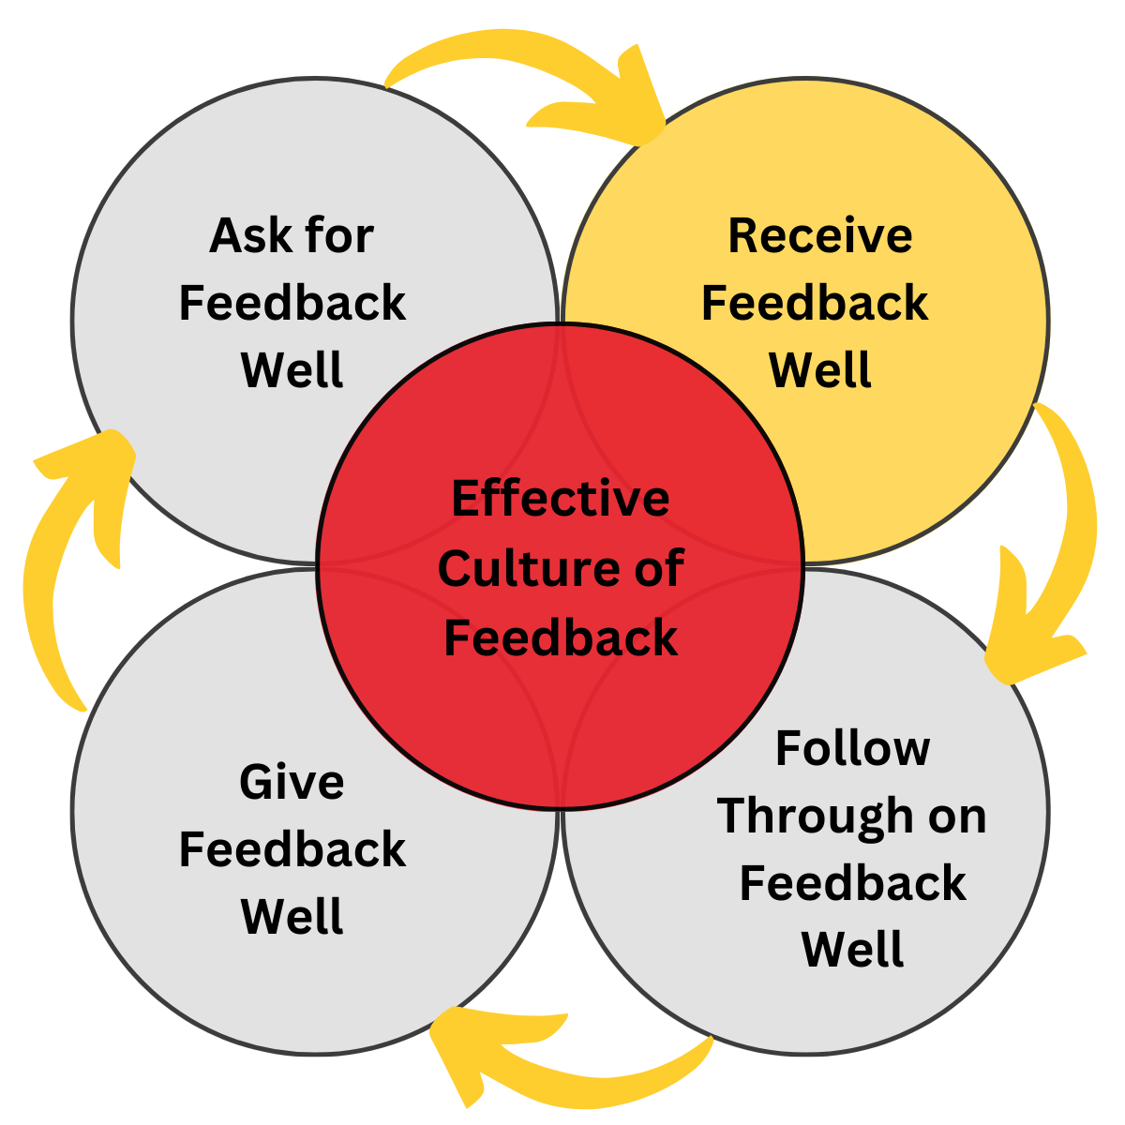
Receive Feedback Well
Be open-minded
Ask questions to clarify
Avoid gut reactions and quick responses
Take notes
Express (genuine) gratitude

Slide 24
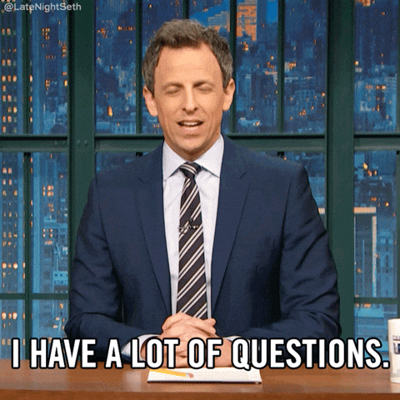
Ask Clarifying Questions
Seek greater detail to truly understand where the issues are.
Seek greater detail to truly understand what the expectations are moving forward.
Thoughtful questions and thoughtful responses drive clarity for all involved.
Notes:
Don’t ask questions that are defensive - didn’t you know? did you not hear….?
Helpful questions: how could I do this differently next time, what would you do differently, etc
Restate what you heard and ask if that is what they meant,

Slide 25
Navigating Healthy Workplace Conflict
Board of Directors Case Study:
Anna Tanski

Slide 26
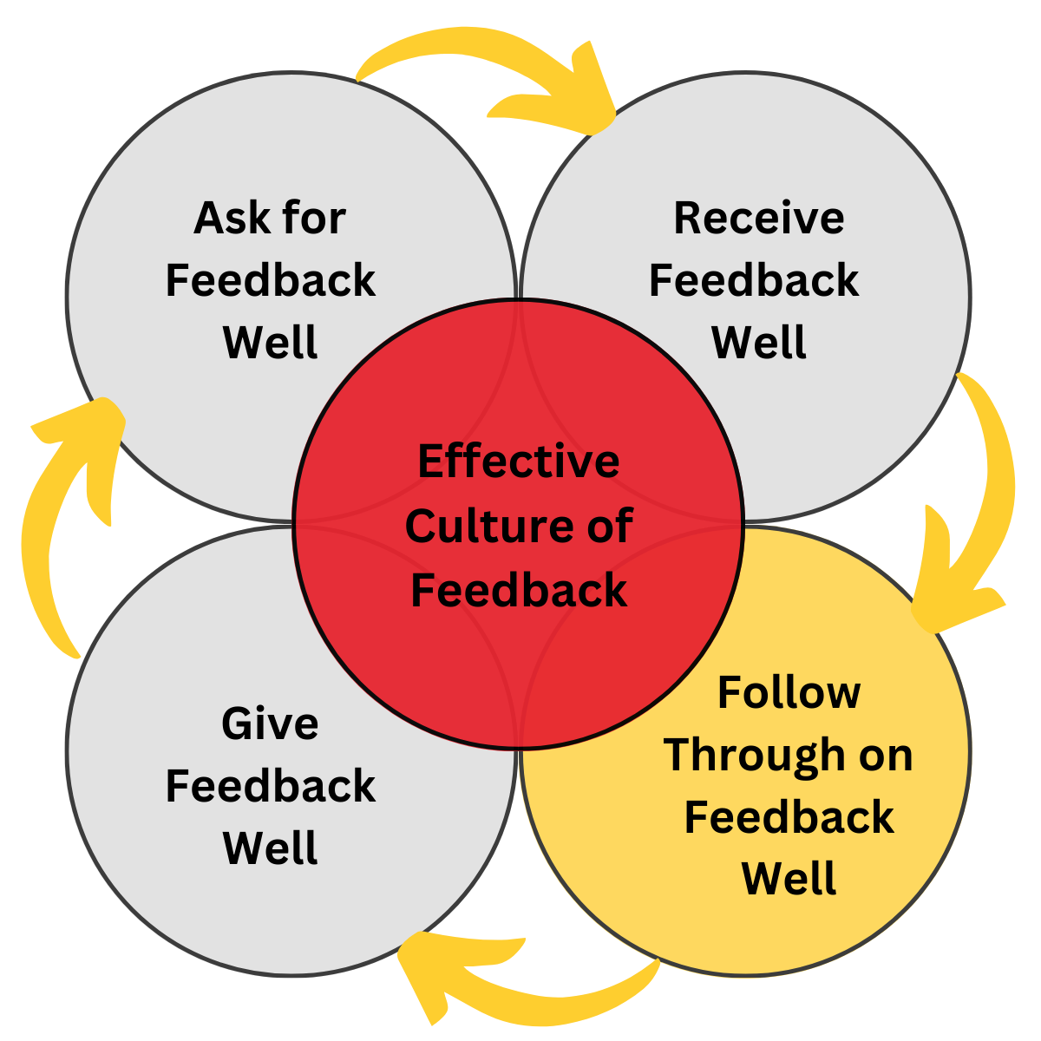
How to Build a Culture of Feedback

Slide 27
Follow Through on Feedback Well
Acknowledge the feedback you’ve received
Implement viable feedback and drive change
Connect changes to feedback received and give credit!
When feedback is received but not viable, explain why

Slide 28
Giving
Feedback Well

Slide 29
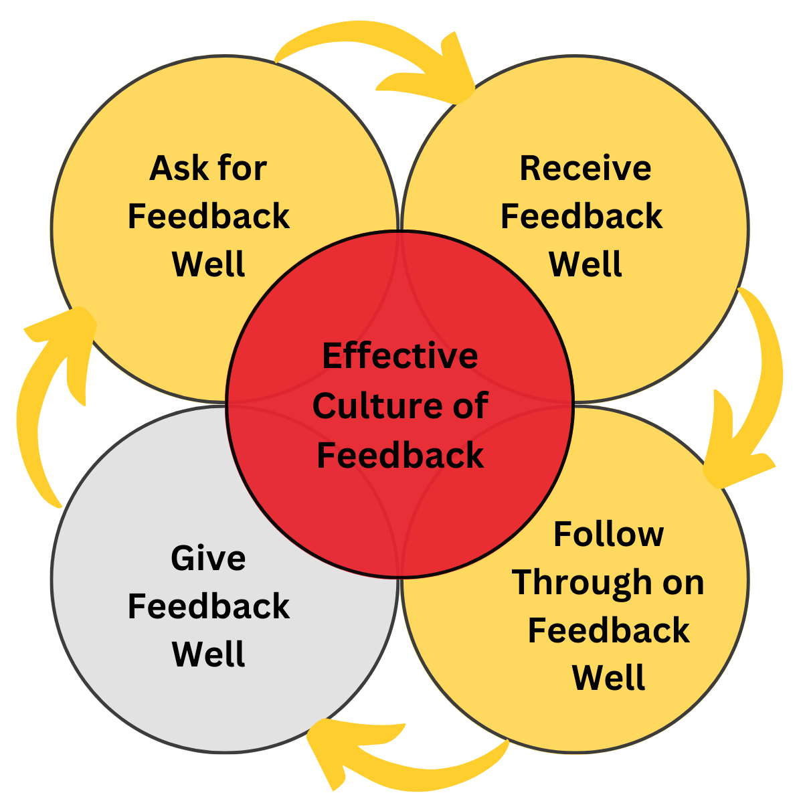

Slide 30
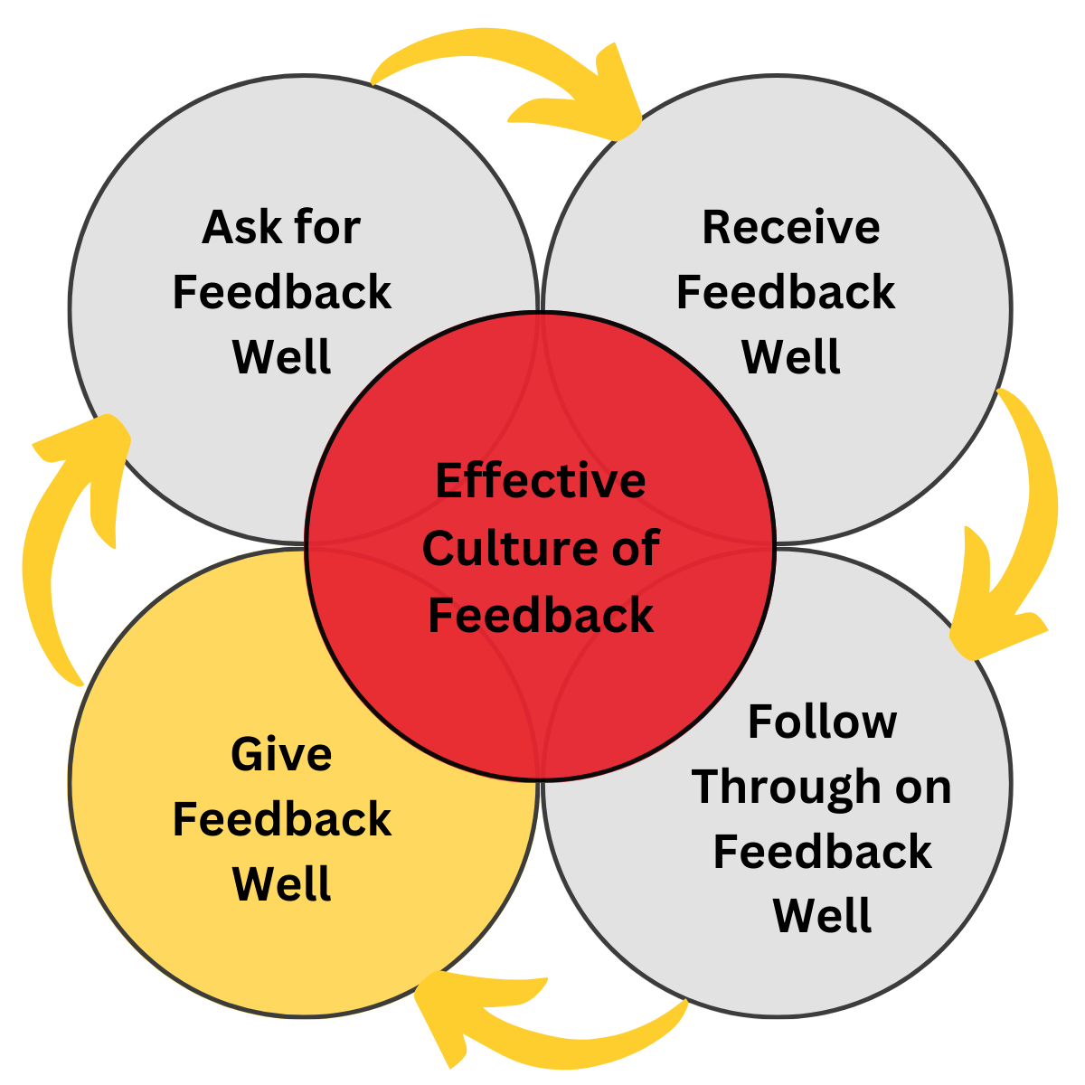
How to Build a Culture of Feedback

Slide 31
Give Feedback Well
Be early
Be specific
Be private
Set clear expectations
Provide resources
Share your support and belief

Slide 32
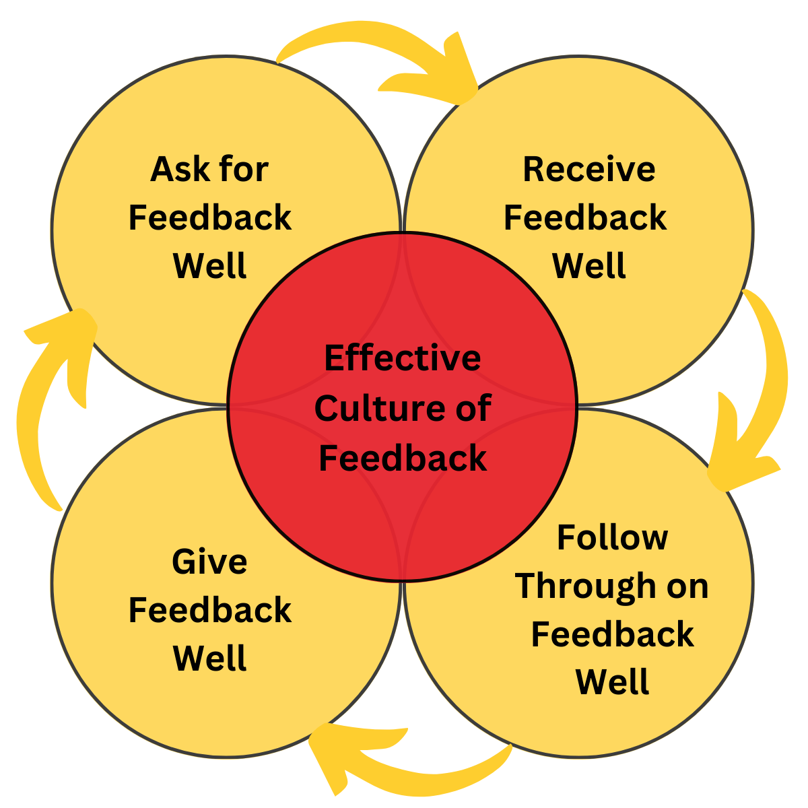

Slide 33
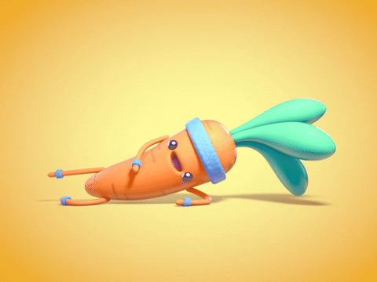
Difficult Conversations Get Easier

Slide 34
Thank You!
Anna Tanski
atanski@firedupculture.com

