Slide 1


Let’s Dish! Serving Up Award-Winning Tourism Marketing
With Kelly Nygaard, Discover Stillwater
&
Ashlee White, Visit Mankato

Slide 2
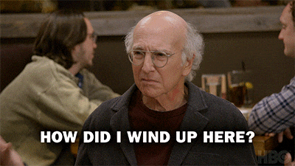
Notes:
If like me, you’re wondering what the heck Kelly and I are doing up here, kicking things off, after an MNTA Karaoke night…

Slide 3
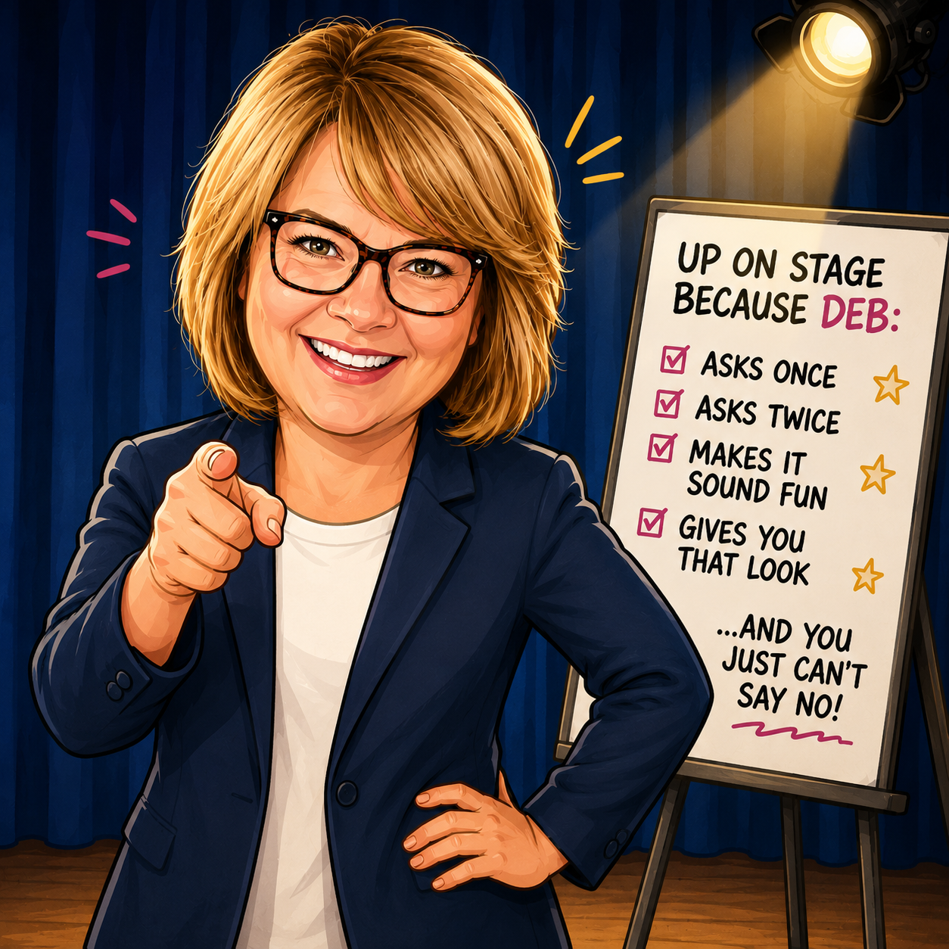
You Can’t Say No To Deb!
Notes:
The answer is you can’t say no to Deb! Deb asked us to present on Award Winning Marketing Campaigns as we both submitted work for the Outstanding Marketing Campaign award for Explore MN for organizations with budgets under $1M.

Slide 4
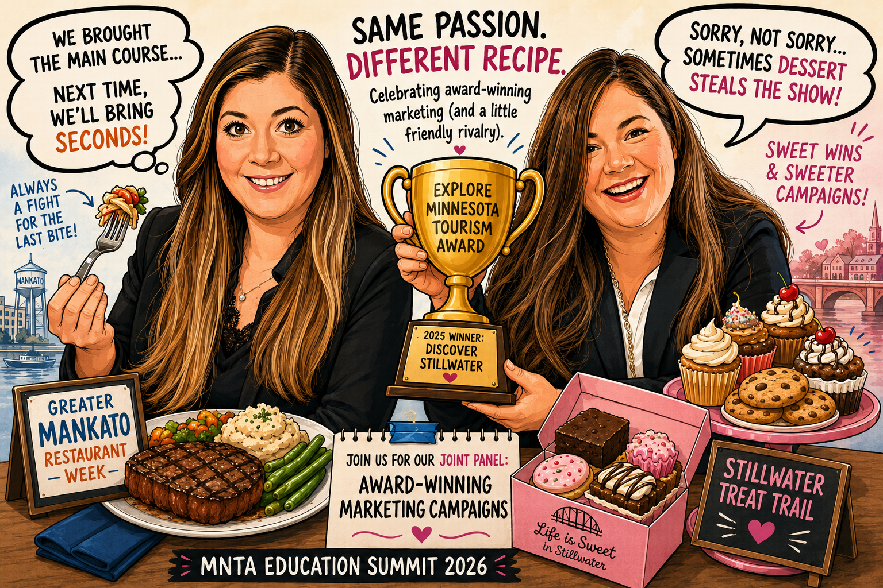
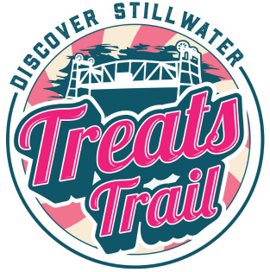

What’s on Today’s Menu
Notes:
Spoiler alert – Visit Mankato was a runner up, and Kelly took home the trophy
Coincidentally, both campaigns that we submitted for were centered around our food scenes.

Slide 5
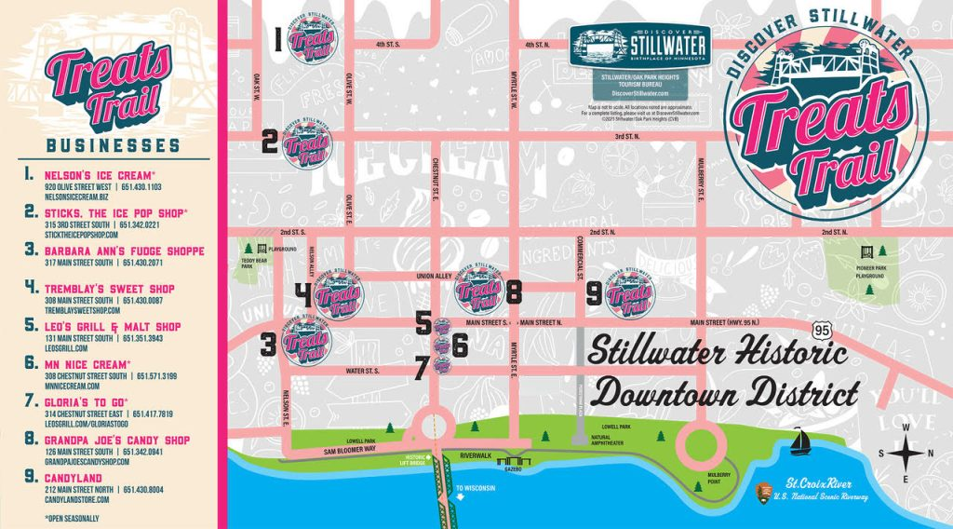
Discover Stillwater’s Treats Trail
9 Participating Businesses
Rounding up all the ice cream, frozen treat and candy shops into 1 fun trail!
Goal: Drive traffic to Stillwater in shoulder seasons and throughout the year, drive traffic to unique business collection, increase awareness of Stillwater as a family friendly destination.

Slide 6
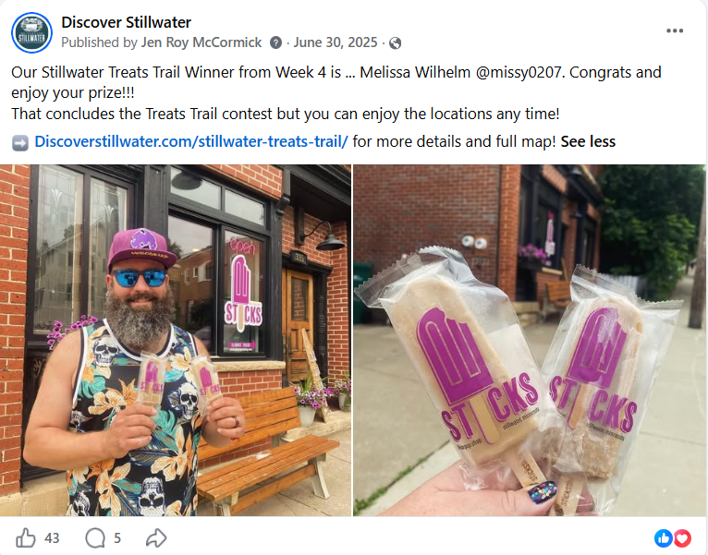
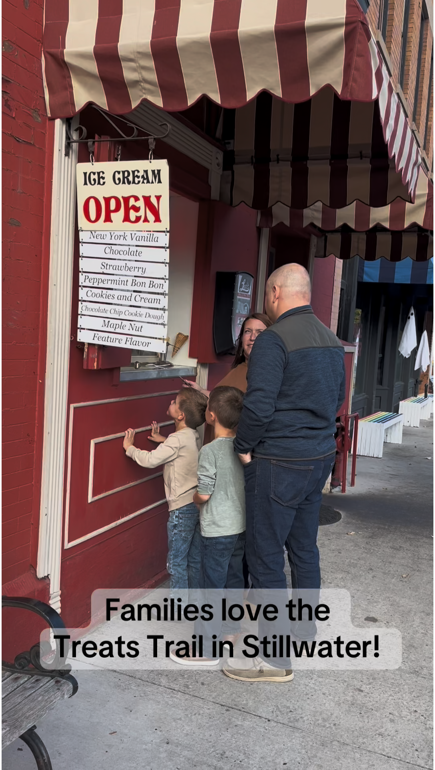
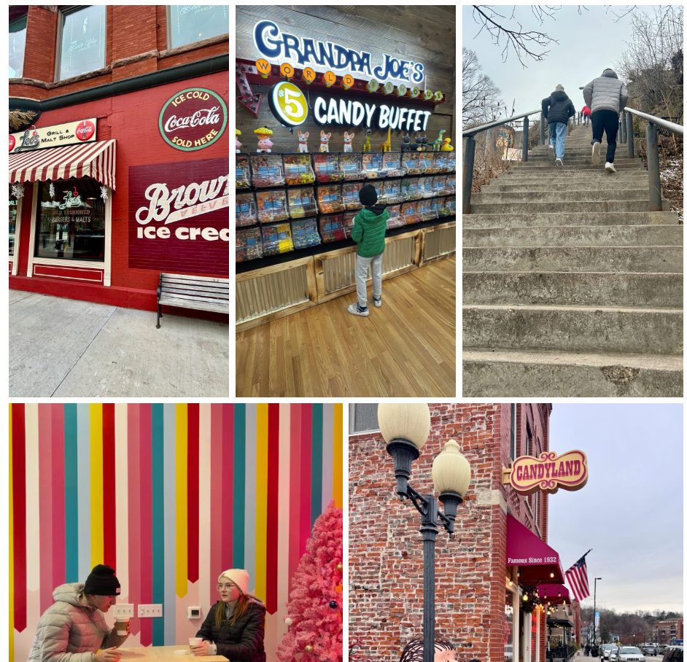
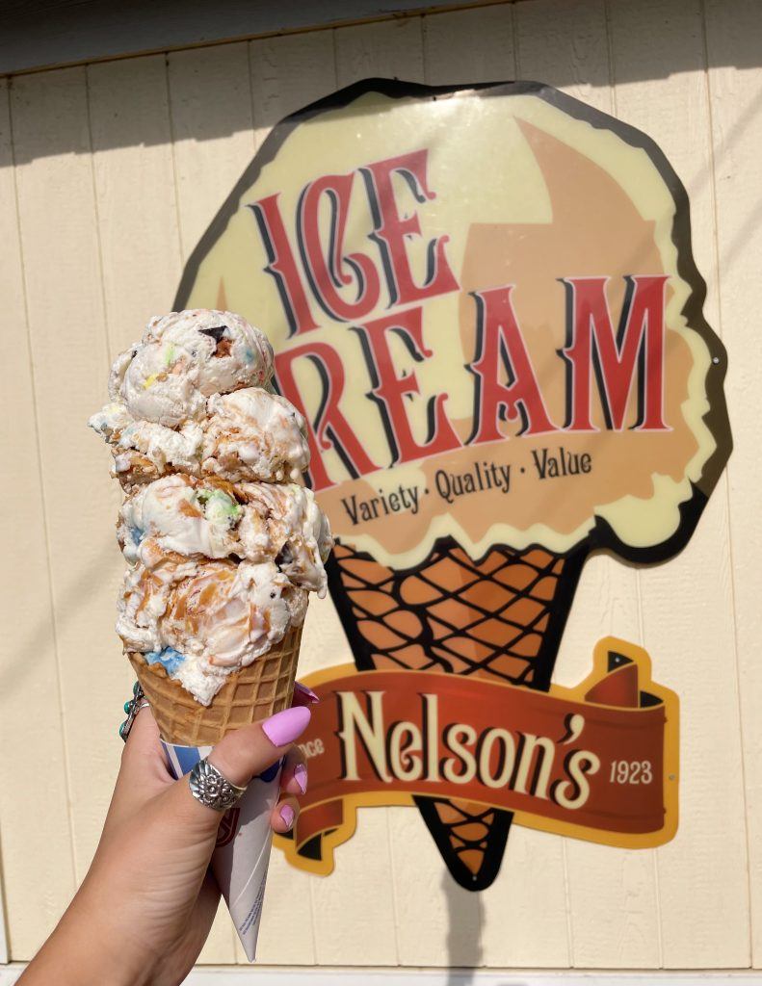
A Carefully Crafted Marketing Recipe
User Generated Content Through Contest
Organic Promotion
Public Relations
Partner Cross- Promotion
Branding/Assets for Partners
Content Creator Collaboration
Multi-Channel Approach

Slide 7
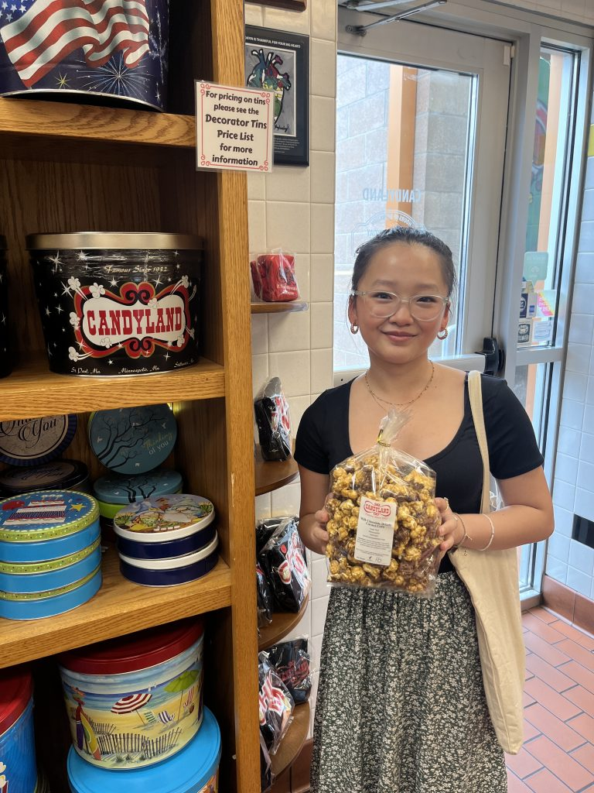
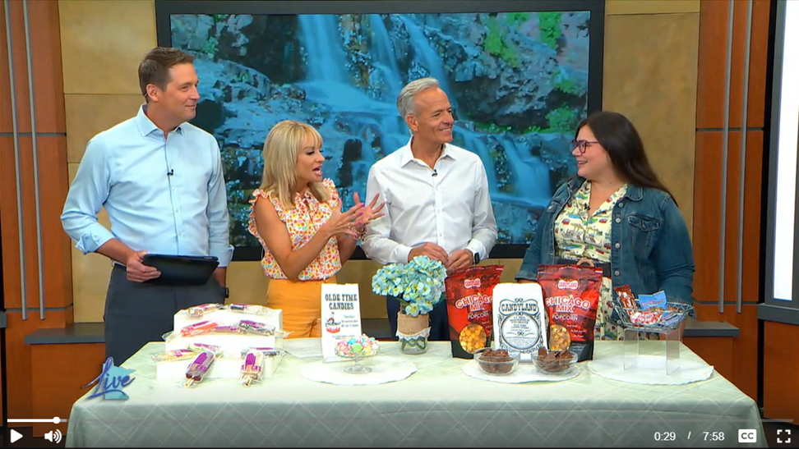
Chef’s Kiss – The Results
Increased foot traffic for off the-beaten path businesses
Enhanced community collaboration
Increased Website Traffic
Re-enforced Stillwater as a family friendly destination
A strengthened reputation for Stillwater as a premier summer destination.
Earned Media: Newspaper, Radio, and TV

Slide 8
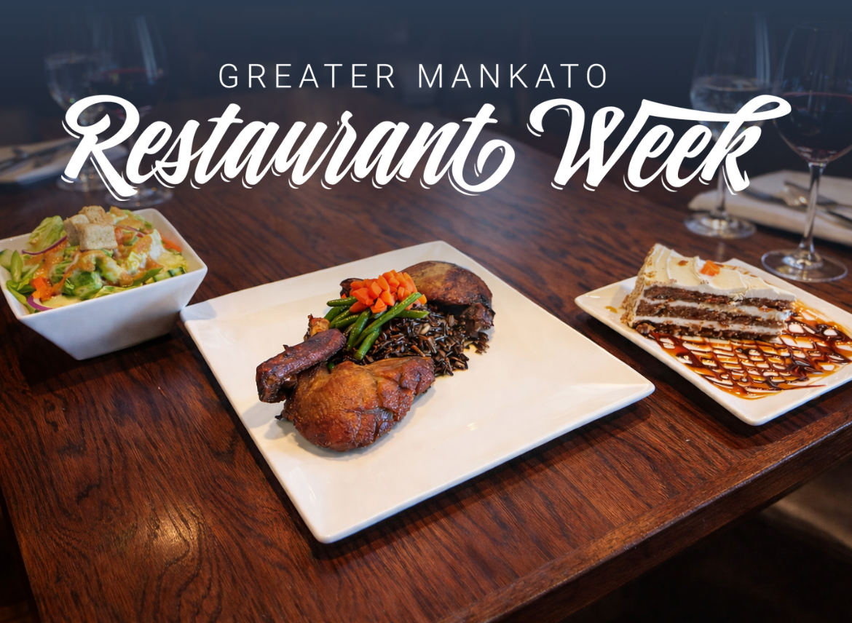
Visit Mankato's Restaurant Week
Designed in collaboration with Downtown Partnership of Mankato/North Mankato, the event took place from February 17-23, 2024.
18 participating restaurants serving up breakfast, lunch, and dinner specials.
Goal: Raise awareness of our diverse local restaurants, successfully position Mankato as an exciting dining destination for visitors, and drive visitation and traffic to businesses during a traditionally slower time of year.

Slide 9
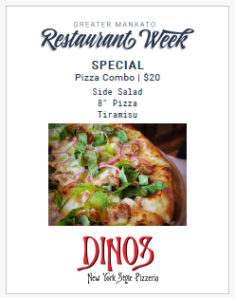

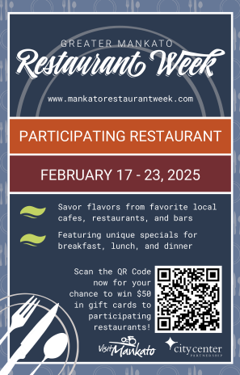

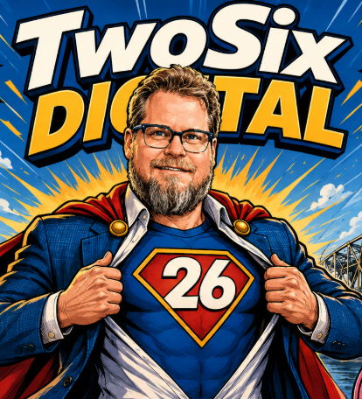
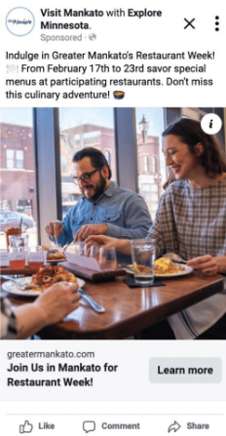
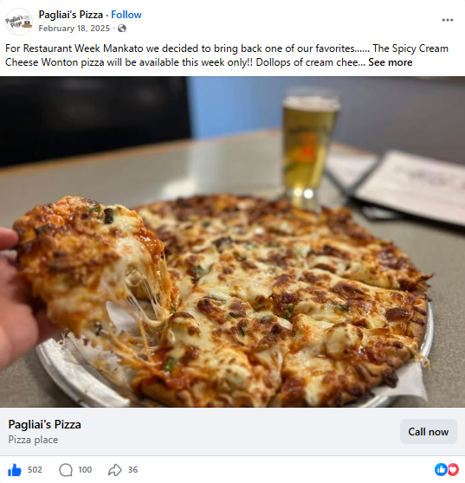
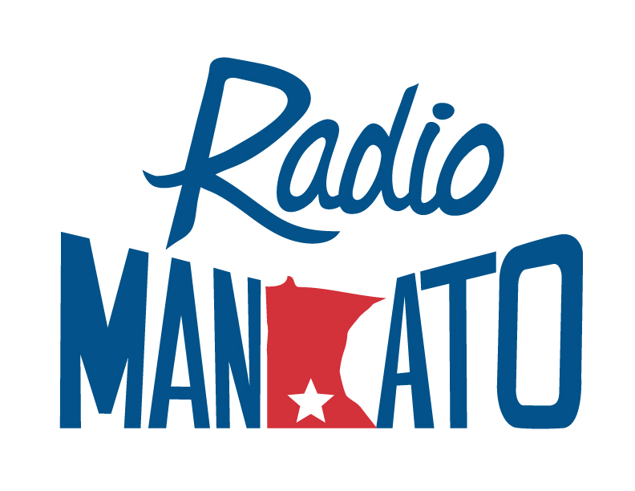


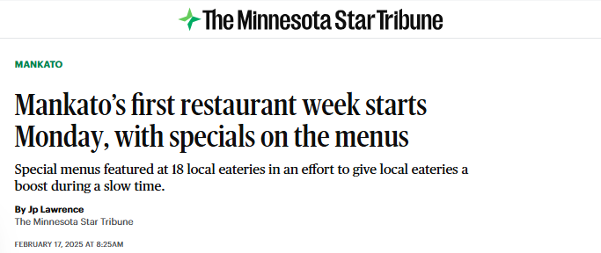
A Carefully Crafted Marketing Recipe
Organic Promotion
Paid Digital
Public Relations
Partner Cross- Promotion
Branding/Assets for Partners
Multi-Channel Approach

Slide 10
Chef’s Kiss – The Results
High Performing Digital Impact:
A targeted paid Meta campaign delivered more than 364,000 impressions and 5,332 link clicks, and a CPC of $0.25
Exceptional Website Engagement:
The Restaurant Week landing page generated the highest number of page views on the entire greatermankato.com website from January through the end of the event period
Increased Awareness of Culinary Offerings in Mankato: event received significant statewide and regional media attention, including coverage in the Star Tribune, Fox 9, KEYC, The Mankato Free Press, St. Peter Herald, Radio Mankato, and six feature segments on Kato Living.
Happy Restaurants and Patrons!: Conducted a post-event survey and received great responses from participating restaurants. Almost all acknowledged an uptick in diners during the week plus new customers who hadn’t dined at their establishments previously.
“I am really excited about how this turned out. It was a cool opportunity to get new people in the door and come together around food across our community. I hope this becomes a yearly event!”
“We had a lot of people that came out specifically because they had heard about restaurant week. Thank You!!”

Slide 11
Our Secret Sauce – Why These Events Were Successful For Our Destinations
High Impact/Low Cost – Remember we’re in the Budget of $1M and under category for the Outstanding Marketing Campaign award
Multi-Channel Approach – Can’t just focus on one platform for success
Thoughtfully Developed Branding – Helps build brand recognition and loyalty
Partnership Driven
  We let the businesses do the heavy lifting / packaged something that’s already available to visitors
  Low cost/no cost for business participation
  Local businesses/restaurants become an extension of the marketing engine by cross promoting to their audiences
Build Something Repeatable
  Visit Mankato now has the marketing framework and branding to have an annual event
  Discover Stillwater can grow their Treats Trail
  Lower lift over time. Easy to grow or adapt each year

Slide 12
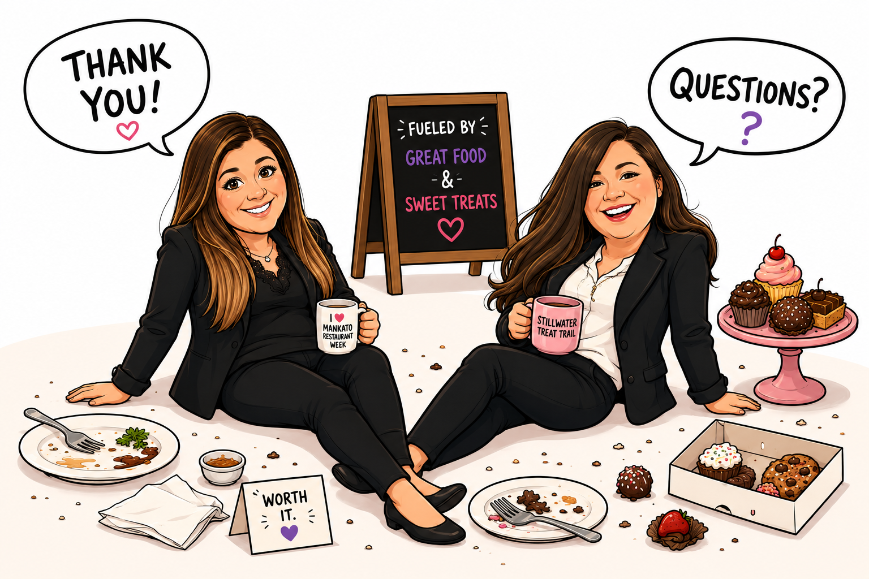
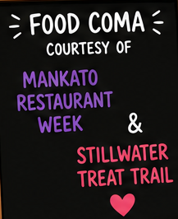
The Kitchen is Closed

Slide 13
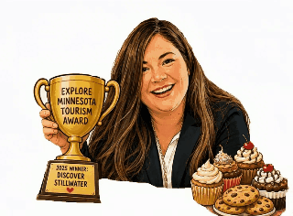
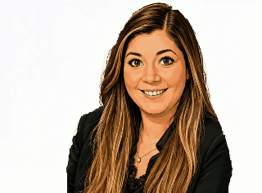
Craving More?
Contact Ashlee:
awhite@visitmankatomn.com
Contact Kelly:
president@discoverstillwater.com

